Slide 1
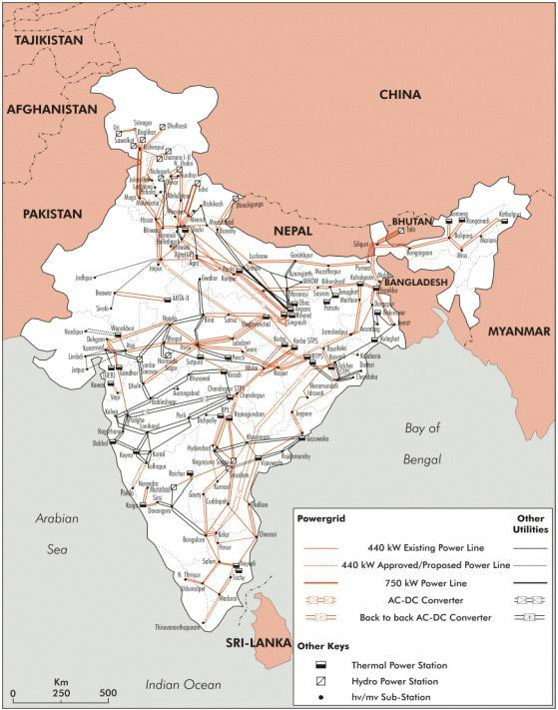
Electricity Consumption in India
WATTSUP Group
November 2023

Slide 2
Agenda
01
Objectives
02
Data Review
03
Time Series Analysis
04
Net Zero emission goals Analysis
05
Q&A

Slide 3
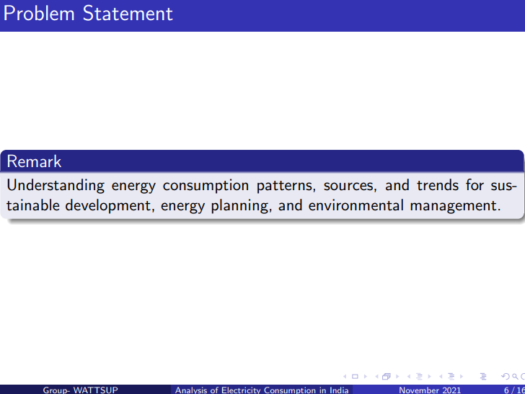
Objectives - What we set out to do

Slide 4
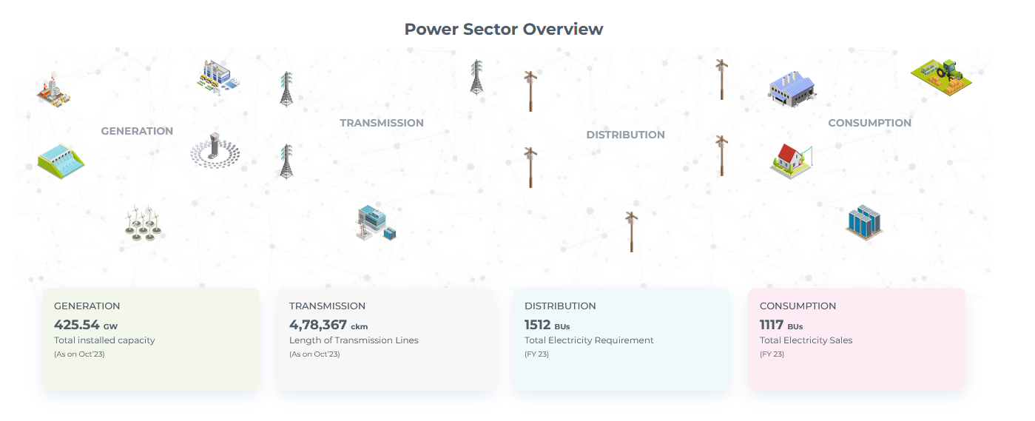
Objectives - What we set out to do
Notes:
3rd Largest producer of electricity in the world
1,435,101 km of transmission lines

Slide 5
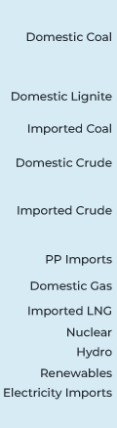
Objectives - What we set out to do
Notes:
3rd Largest producer of electricity in the world
1,435,101 km of transmission lines

Slide 6
Objectives - What we set out to do
10 Times Length of NH
Notes:
3rd Largest producer of electricity in the world
1,435,101 km of transmission lines

Slide 7
Objectives - What we set out to do
10 Times Length of NH
62 DISCOMS

Slide 8
Objectives - What we set out to do
10 Times Length of NH
62 DISCOMS
CONSUMERS

Slide 9
Objectives - What we will attempt to do
Time series Analysis
Undertake time series analysis of peak electricity consumption and attempt to model the time series
Net Zero emission goals
COP26
Reduce Fossil fuel dependence to 50
Net Zero carbon emission by 2070
Analyse if we are on track to achieve net zero emission by 2070

Slide 10
TIME SERIES ANALYSIS

Slide 11
Data Review
Characteristic | Description | Remarks
Source | Niti Ayog Website | https://iced.niti.gov.in/
Period | 20 Apr 17 to 06 Nov 23
Periodicity | Daily
Observation in MW | Daily Peak Demand | in MW
No of Observations | 2390
Range | 115232 to 239978 | in MW

Slide 12
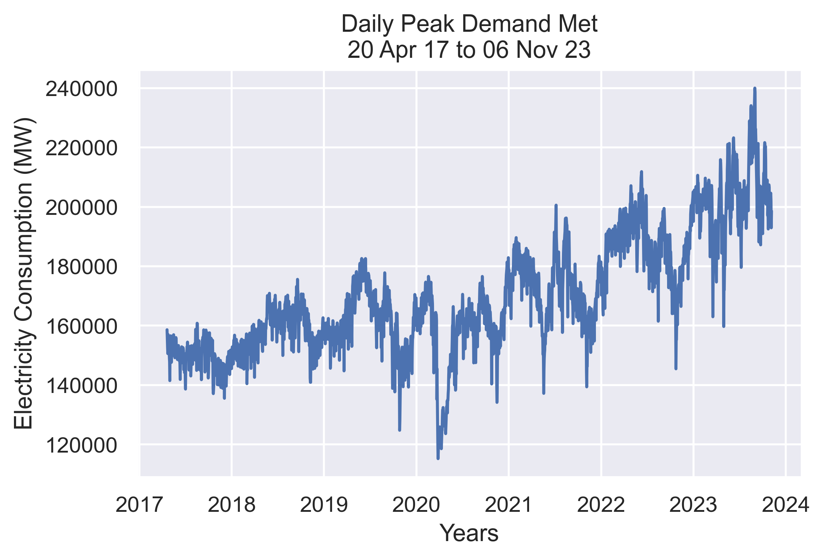
Plot of The Data
Data Source: https//iced.niti.gov.in/

Slide 13
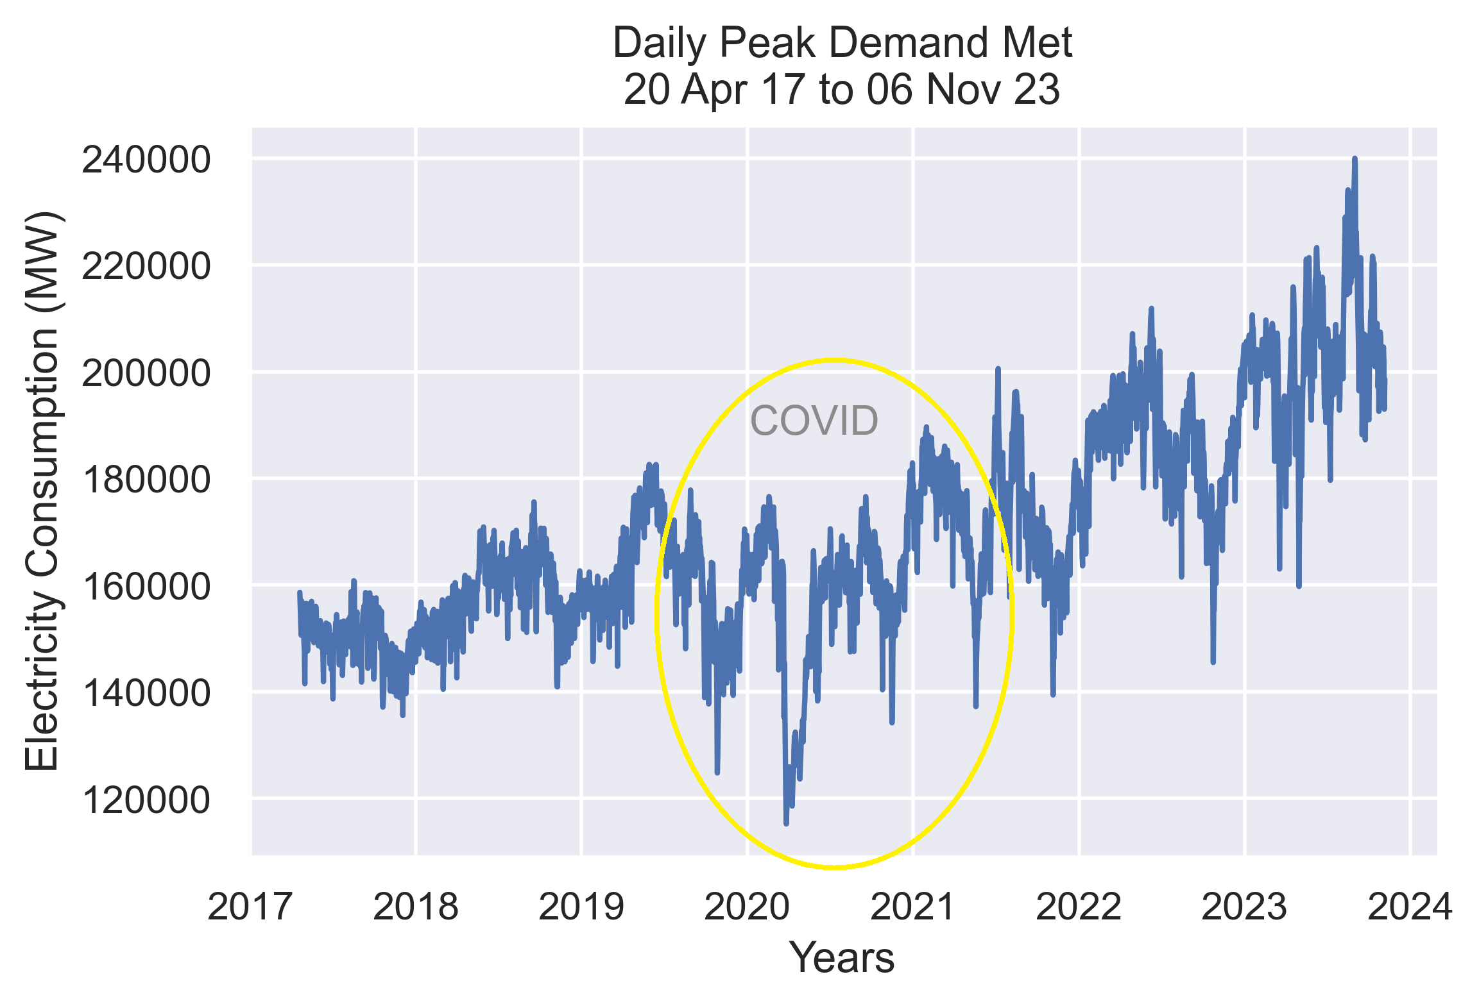
Plot of The Data
Data Source: https//iced.niti.gov.in/

Slide 14
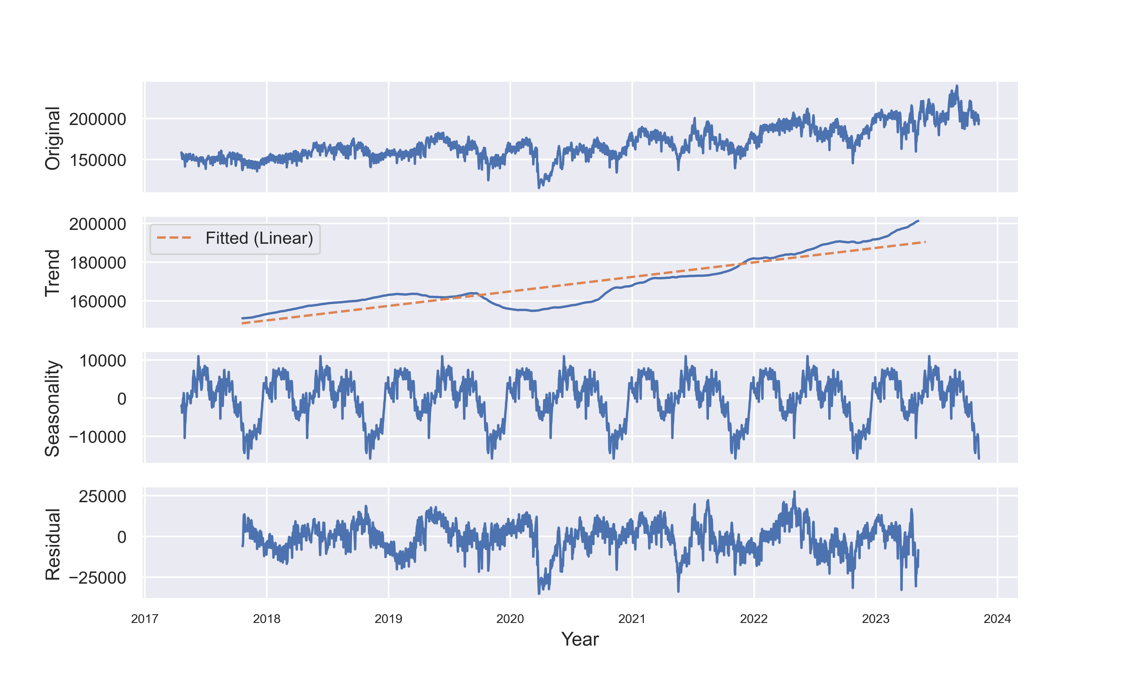
Time series-Decomposed (Yearly Seasonality)
Data Source: https//iced.niti.gov.in/

Slide 15
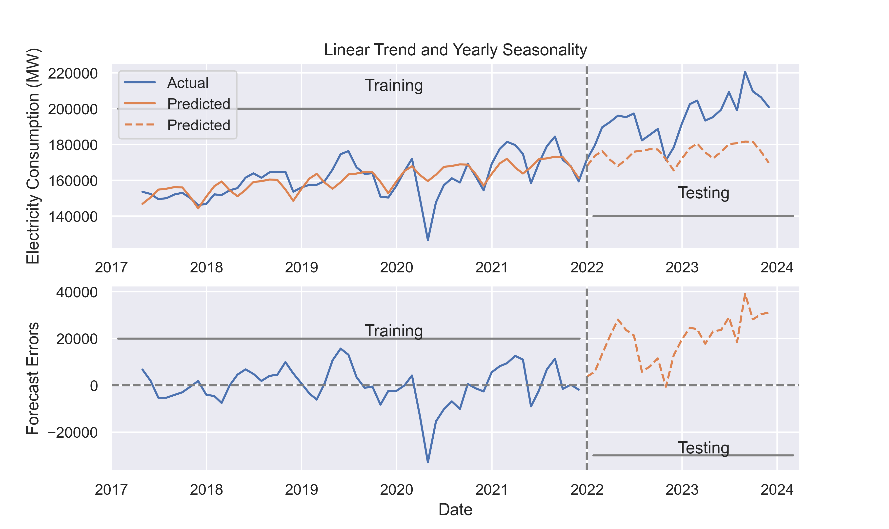
Train/Test- Linear Trend with Yearly Seasonality (Ordinary Least Square)
Data Source: https//iced.niti.gov.in/

Slide 16
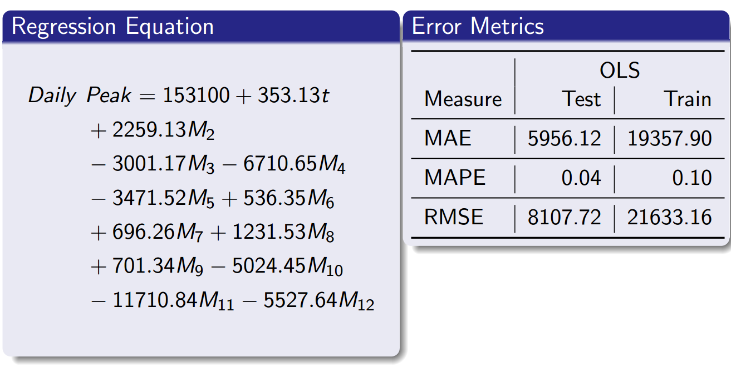
Train/Test- Linear Trend with Yearly Seasonality Error Metrics
Data Source: https//iced.niti.gov.in/

Slide 17
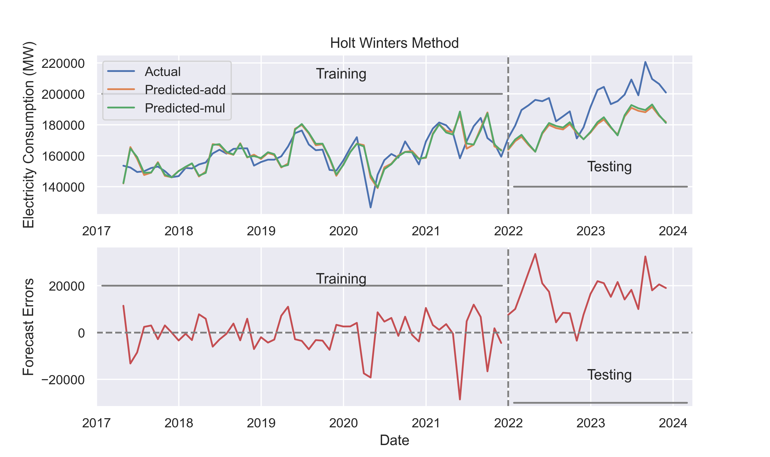
Smoothing - Holt Winters Method with additive and multiplicative seasonality
Data Source: https//iced.niti.gov.in/

Slide 18
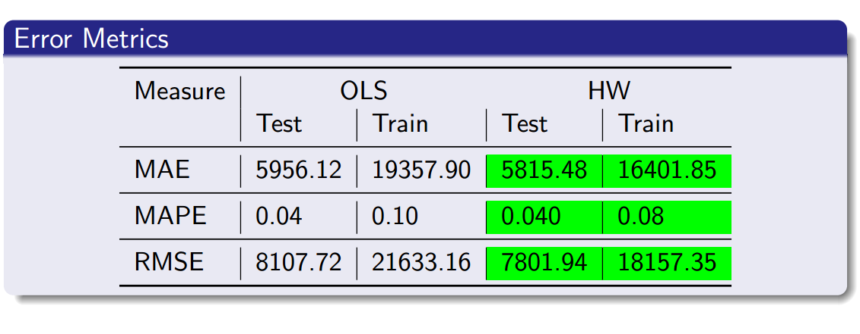
Error Metrics - OLS vs Holt Winters
Data Source: https//iced.niti.gov.in/

Slide 19
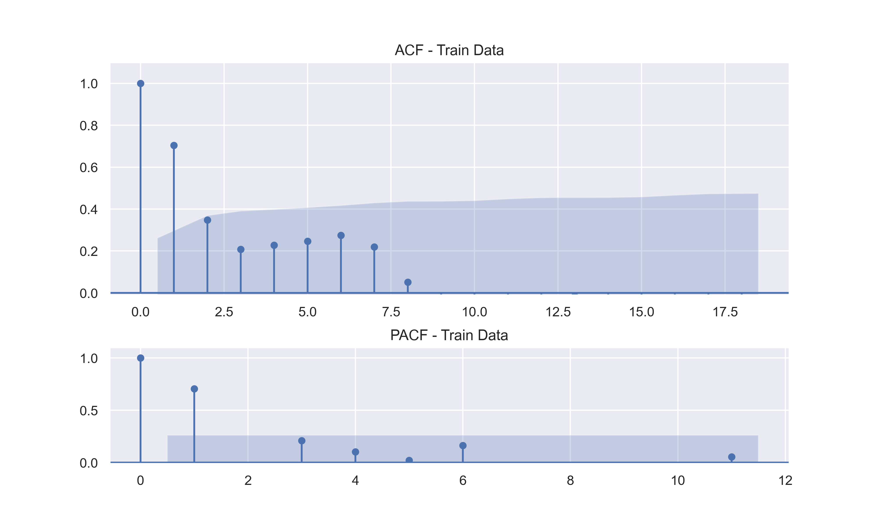
Autocorrelation- ACF and PACF of original series
ADF
P Value – 0.1072
Data Source: https//iced.niti.gov.in/

Slide 20
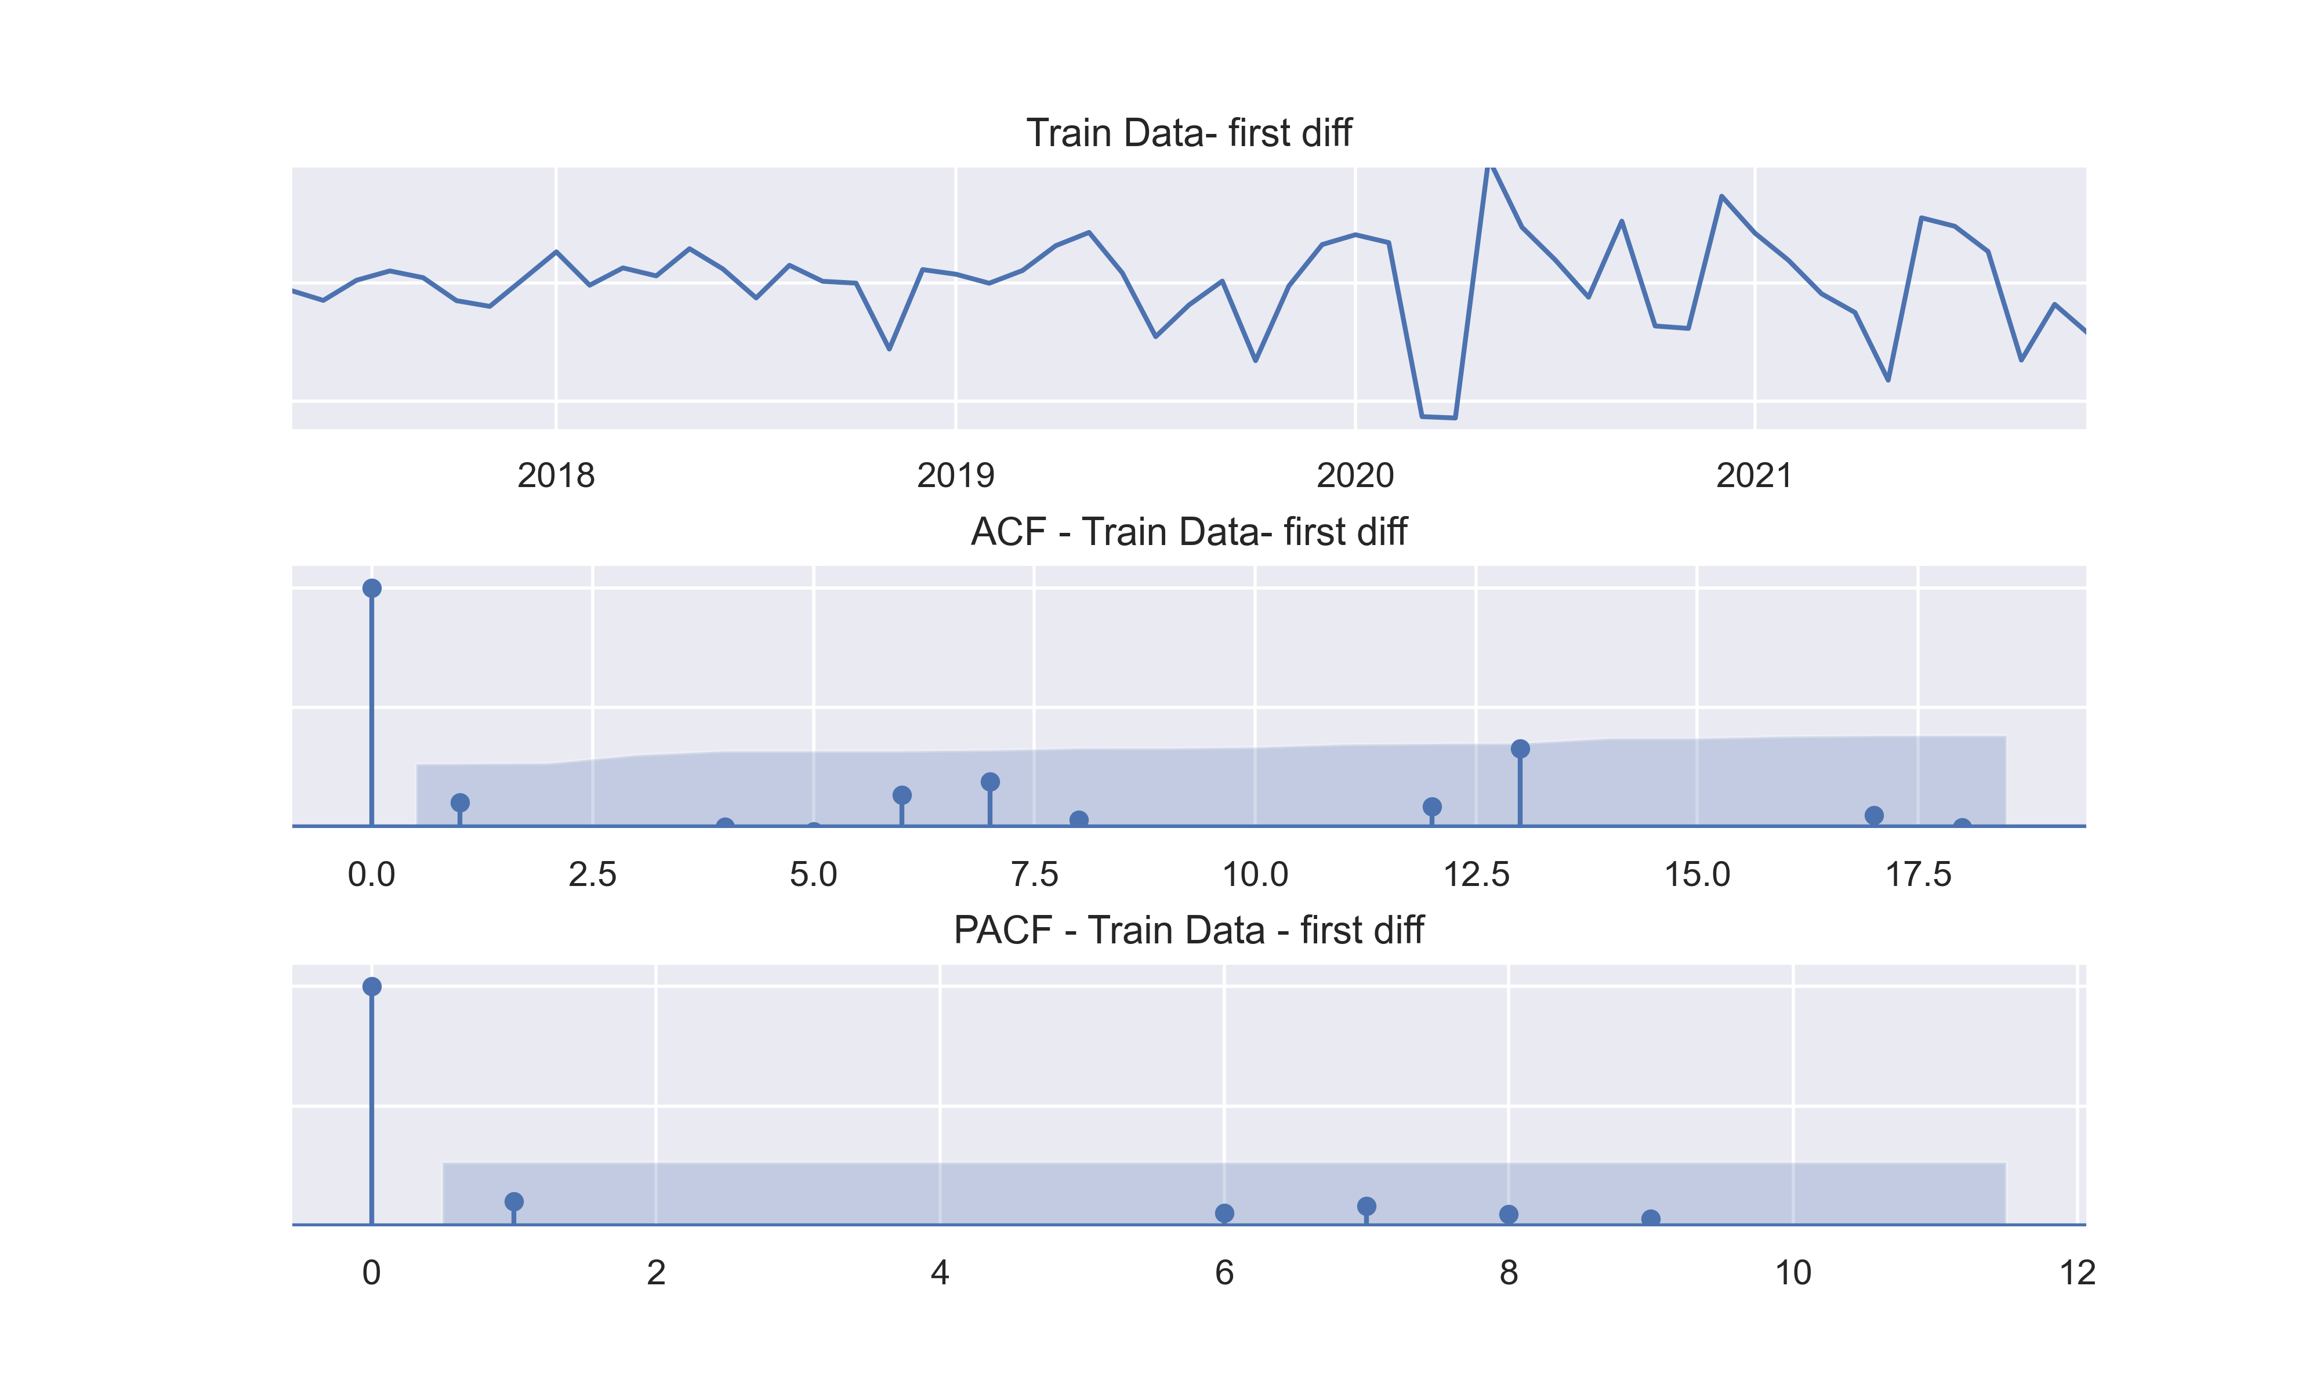
Differencing the series - ACF and PACF
ADF
P Value – 7.23 e (-6)
Data Source: https//iced.niti.gov.in/

Slide 21
Differencing the series - ACF and PACF
ARIMA(0,1,0)
ADF
P Value – 7.23 e (-6)
Data Source: https//iced.niti.gov.in/

Slide 22
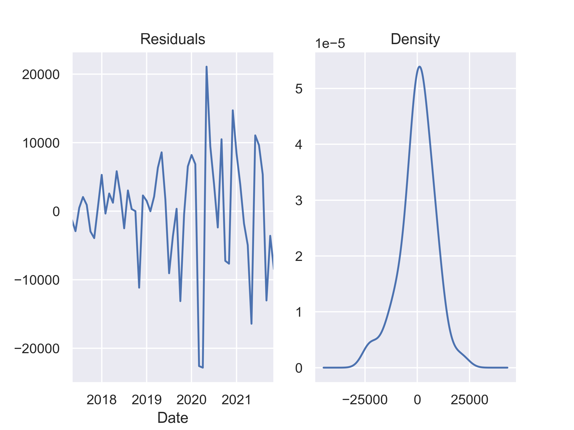
ARIMA (0,1,0) - Residuals
Shapiro
P Value – 0.07
Data Source: https//iced.niti.gov.in/

Slide 23
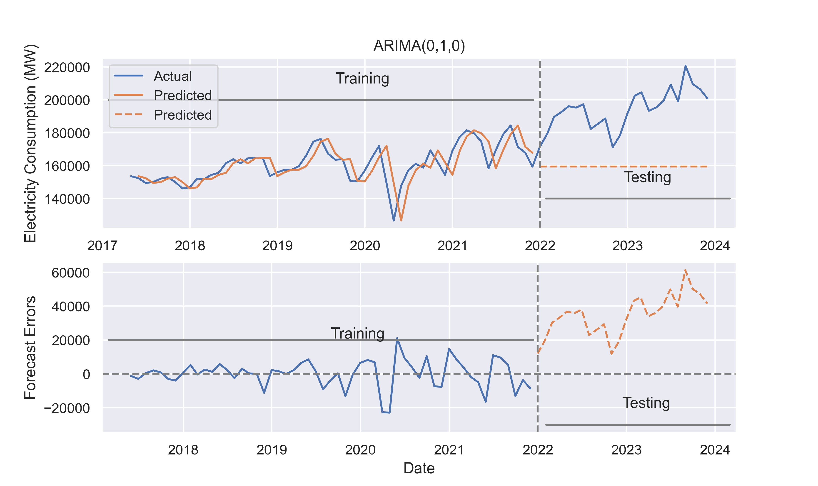
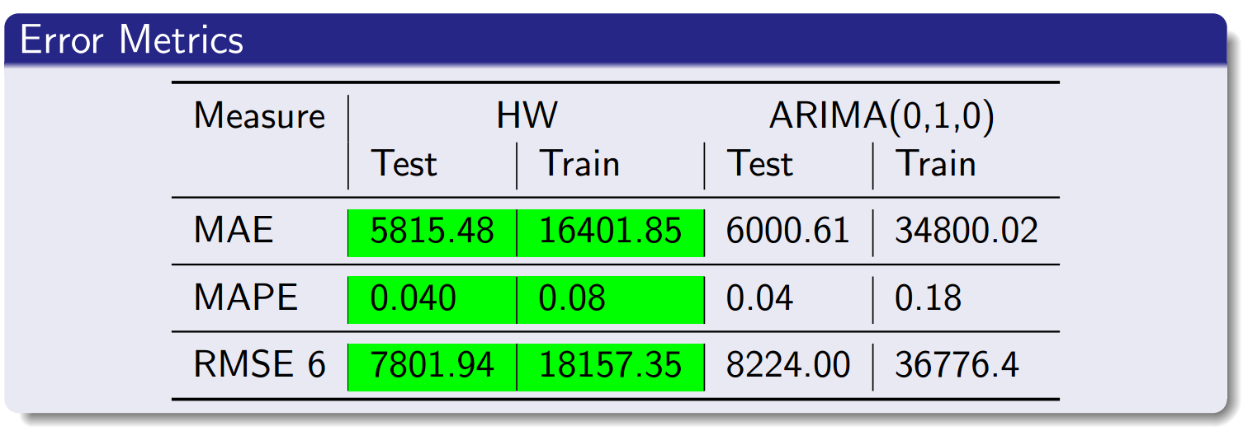
Error Metrics Holt Winters vs ARIMA (0,1,0)
Data Source: https//iced.niti.gov.in/

Slide 24
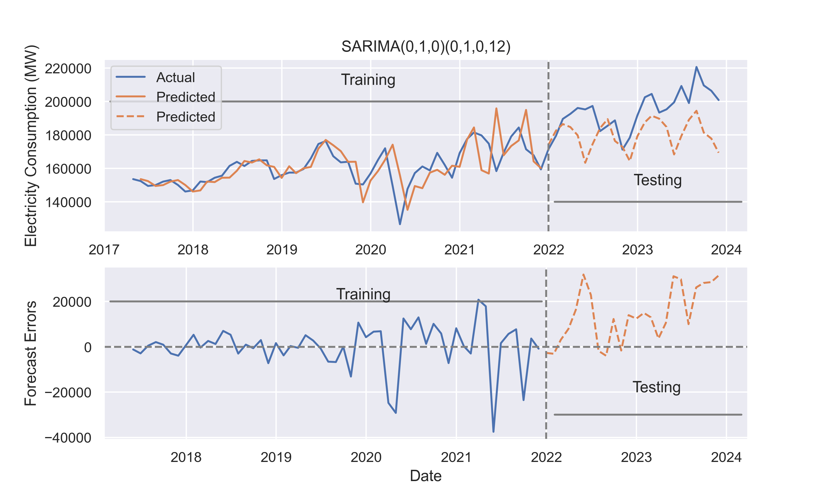
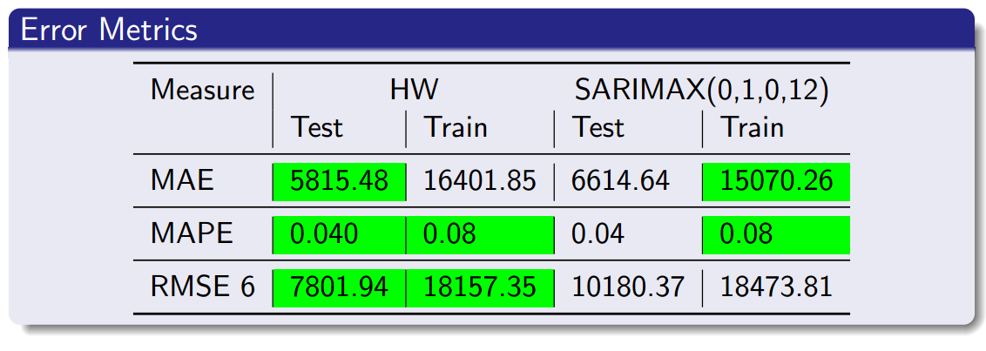
Error Metrics Holt Winters vs SARIMAX (0,1,0) (0,1,0,12)
Data Source: https//iced.niti.gov.in/

Slide 25
Defining Problem Statement
Why is it Necessary
The rapid growth of electric consumption in India has become a significant concern, with a rising demand of electricity across various sectors. This analysis aims to analyze and understand the patterns and factors contributing to electric consumption in India and identify potential issues that can be addressed through this analysis
What will we Achieve
Resource Management : Efficient resource allocation by recognizing consumption pattern
Energy Efficiency : Identifying inefficiencies to reduce wastage
Environmental Impact : Mitigating environmental effects through sustainable energy practice
Cost Savings : Empowering both government and consumer to reduce cost
Grid Stability : Ensure reliable electricity supply
Policy Formulation : Data driven policy making for the energy sector
Infrastructure Planning : Adequate infrastructure development aligned with demand

Slide 26
Defining Problem Statement
This analysis aims to analyze and understand the patterns and factors contributing to electric consumption in India and identify potential issues that can be addressed through this analysis
Why is it Necessary
Future Energy Demand :
India’s electricity demand will grow up by ~70% by end of this decade from current consumption. To meet the future energy demands India need to focus on Renewable and other non fossil sources. India has set a target of producing 500 GW of renewable energy by 2030. This includes 280 GW of solar power and 140 GW of wind power
Carbon Emission :
India contributes to 7% of total global carbon emission. Out of which ~45% of the carbon was emitted by thermal coal plants. To fight the pollution India has decided :
Reduce the carbon intensity of the economy by less than 45% by the end of the 2030
Achieve Net Zero carbon emissions by 2070 (Announced by PM Modi in UNFCCC meet, Glasgow Nov’21)
Cost Savings :
India is the second largest coal importer in the world, after China. In 2020, India cut its coal imports by 12.4%. India's coal imports have risen by 38.2% to Rs. 1,38,477 crore in 2017-18.
Cost of the electricity generated by thermal plants is higher compared to Hydro, Wind and Solar energy
Self Sufficient:
(Source: https://cea.nic.in/?lang=en)

Slide 27
Steps Involved in the Analysis
Data Collection : Historical data on electricity energy consumption, production, loss and related factors for different states and sectors
Source: indiastat.com - under power category
Data Preprocessing : Univariate and Bi-variate analysis to handle missing values, outliers and data inconsistencies.
Descriptive Analysis : Visualizing trends, variations and patterns in energy consumption across regions and sectors
Temporal Analysis : Consumption over time considering :
a) Population growth
b) Economic development
c) Technological advancements
Spatial Analysis : Regional Disparities in energy consumption
Source Analysis : Analyze shift in energy source and its implications
Sectoral Analysis : Energy consumption by sectors

Slide 28
Status
S.No | Data Description | Duration
Status
1 | Electricity Consumers | 2008-2021
2 | Electricity Tariff and Duty | 2011,2015,2021
3 | Electrification | 2002-2022
4 | Power Allocation | 2010-2019
5 | Power Connected Load | 2010-2021
6 | Power Consumption and Sale | 2011-2022
7 | Power Generation | 2014-2023
8 | Transmission and Distribution | 2013-2022
Data Downloaded.
Preprocessing in Progress

Slide 29
Electricity Consumption in India
India’s electricity consumption has gone up by 65% in last decade and the demand is estimated to reach 1.5 times by 2030. To
meet future demands and to ensure we generate clean energy India needs to expand electricity production from renewable sources
Total Electricity Consumption (in TWH)
Growing population along with increasing electrification and per capita usage to drive growth in power consumption
Electricity consumption in India grew by avg 6% YoY and India become 3rd largest producer of electricity in the world
India has become a power surplus country and a net exporter of electricity
India aims to produce 50% of its electricity from non-fossil fuels by 2030
Add electricity production data in this graph
Total Electricity Consumption by Sector (in TWH)
Industry sector has the highest share of consumption avg ~40% followed by Domestic ~25% and Agriculture ~18%
Domestic sector consumption demand is growing faster then other sectors at avg 7% YoY
Data Source : https://mospi.gov.in/publication/energy-statistics-india-2023
Due to non availability of the data, the consumption value is taken equivalent to production value.

Slide 30
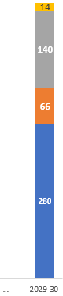
Macro Perspective
Energy Consumption Share %
India announces its ambitious plan to achieve net-zero carbon emissions by 2070
India Contributes to 7% of global carbon emission
Coal thermal plants contributes to ~45% of the total carbon emission in India alone.
~ 85% of India’s electricity comes from fossil fuel. Share of Coal is ~45 - 50%, Oil ~25% , gas is 10%
Though renewable capacity grew by avg. 10% YoY but the growth rate fell short in front of growing demand
Renewable Energy Installed Capacity (GWH)
India has set a target of producing 500 GW of renewable energy by 2030. This includes 280 GW of solar power and 140 GW of wind power
Only solar installed capacity grew by avg 45% YoY, not much was done to increase installed capacity for other sources in last decade
As on 30 November 2019, India had an installed power capacity of 365.9 GW, of which coal dominated with 56%, followed by RE at 23%, hydro at 12%
With the current growth rate, we will fall short by ~37% for Solar and ~55% for Wind power generation
178
500
Target
Data Source : https://mospi.gov.in/publication/energy-statistics-india-2023 ; https://iced.niti.gov.in/
Notes:
https://www.drishtiias.com/daily-updates/daily-news-editorials/power-sector-in-india

Slide 31
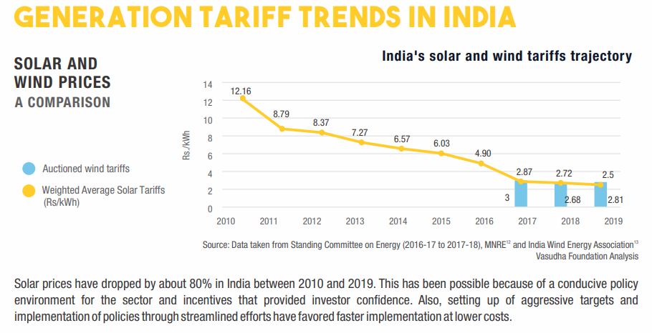
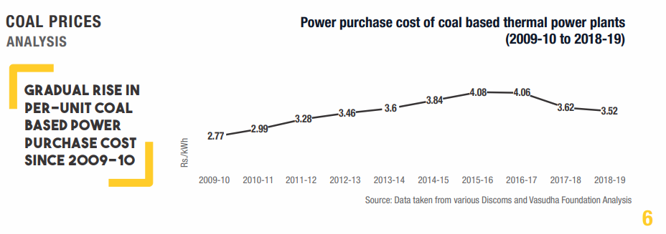
Cost of Electricity to End Consumer
Decline in tariffs of renewable energy in last decade indicates that India should focus more on clean energy
Source: https://shaktifoundation.in/wp-content/uploads/2021/12/POS_Current-State-Of-Play-2020.pdf

Slide 32
Where we are continued
Graphs for :
Coal prices and Imports
Coal availability status and forecasting. – decline in availability of coal
Prices of electricity produced from Different sources – to
Placeholder
https://shaktifoundation.in/wp-content/uploads/2021/12/POS_Current-State-Of-Play-2020.pdf

Slide 33
Future Demand
Need to add yearly renewable consumption data
Forecasted
India’s energy consumption demand grew up by 48% in 2030 compared to 2020 .
India needs to prepare ~900 TWh electricity through clean energy to curb 50% of carbon emission. To achieve this target India has to increase its clean energy growth by xx% YoY. (In FY 2022 India generated 165 TWh clean energy)
Info & Content :
a) Model tested for best fit : Holtz Winter, ETS, SES, ARIMA c) Python notebook and source code :
b) Model Used for Forecasting : SARIMA

Slide 34
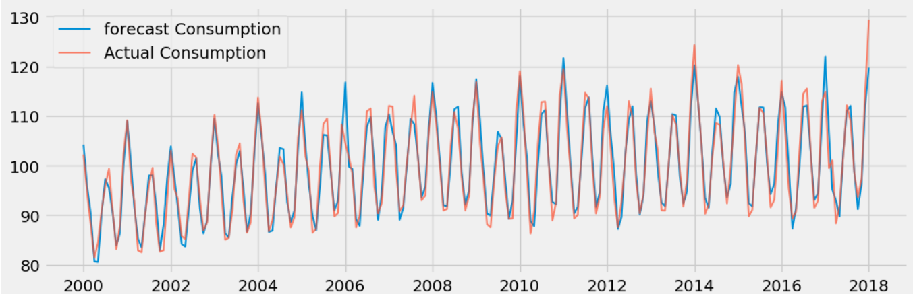
Forecasting Model Test
Actual Consumption vs Forecast consumption has a good overlap
Sample forecasting vs actual data (monthly)
Date | Actual Consumption | forecast_boxcox | forecast
9/1/2017 | 98.62 | 4.59 | 98.74
10/1/2017 | 93.61 | 4.51 | 91.22
11/1/2017 | 97.34 | 4.57 | 96.28
12/1/2017 | 114.72 | 4.72 | 112.16
1/1/2018 | 129.40 | 4.79 | 119.75

Slide 35
Future - Placeholder
Are we meeting all the targets set by ministry ?
Will we meet the demand in the future ?
Forecasting of renewable energy production
Demand growth by sector and regions..
Placeholder

Slide 36
Consultative
What should we do to achieve targets/demands
Best practices from Countries who are producing green energies (US, Germany, UK , etc)
Potential vs Actual production of electricity (Clean Energy)
Placeholder

Slide 37







India’s Energy Mix Strategies
Larger shift toward Clean Energy alternatives
Increased Manufacturing Capacities
Energy Use Efficiency
Placeholder
Policy push for Hydrogen including production-linked incentives
Launch of Global Biofuel Alliance
Usage of Technology such as CCUS (Carbon Capture, Utilization and Storage)
Emerging technologies on Table: 2G Ethanol Pilot, Comfort climate box for tropical regions, Hydrogen Valleys, Heating and cooling virtual repository
https://pib.gov.in/PressReleaseIframePage.aspx?PRID=1961797

Slide 38

Best practices
Sustainable Public Transport
Investing in Green Tech
(Set to become the world’s first fossil fuel free nation)
Green Agriculture
(Creation an agrarian framework, supporting worldwide food security in developing economies)
Sustainable Lifestyle
(Usage of Organic Cotton & Organic Foods)
Reforestation & Recovery of Wet Lands
Ban New Coal, Oil and Gas extraction projects
End direct Fossil Fuel subsidies
Shutting down of 69% of coal-fired power plants
Placeholder
Notes:
Potential vs Actual angle (state wise)

Slide 39
Q&A

Slide 40
Appendix

Slide 41




Renewable Energy – Achievements till date
1000+ GW Potential (173 GW Installed). Globally 4th position in overall Renewable Energy.
42% Cumulative Installed Capacity from non-fossil fuel sources, 50% targeted till 2030
Renewable Power generation increased nearly 3 times from 61 BU to 180 BU since 2014-15
Solar Power installed capacity increased approx. 30 times from 2.6 GW to 70.10 GW since 2014
Wind capacity increased 2 times from 21 GW to 42.8 GW since 2014
About $78 Billion investment since 2014 (including $10.27 Billion FDI)
3rd highest RE capacity addition of 63 GW in last 5 years
Other Installed Capacity for Renewables:
Biomass/Co-generation: 10.2 GW Small Hydro Power: 4.94 GW
Waste to Energy: 0.55 GW
Large Hydro: 46.85 GW
Notes:
Achievements - https://mnre.gov.in/
Carbon emission by our country

Slide 42
Macro Perspective
India with an estimated GDP growth of over 6% and to achieve its developmental goals, transitioning to a clean energy-based economy is crucial
Increased focus on Renewable Sources of Energy going forward, to match increasing demands of various sectors and regions
Need to transition away from geographically concentrated fossil fuel resources to more equitably distributed renewable power may lead to a more stable global energy market.
Cost effectiveness of Renewable Energy Sources
Fulfill aim of a Self-reliant India.
Energy Consumption Share %
Consumption of Energy by Source (TWH)
Fossil fuel derived energy generation: Thermal power based on fossil fuel such as coal, natural gas and diesel accounts for 80% of the country's generation.
Higher Cost of Fuel: Coal extraction from state-run Coal India (a near-monopoly), has stagnated due to delayed environmental clearances, land acquisition troubles and little investment in advanced technologies.
Many power companies have to look for coal mines overseas and source more expensive imports (despite having abundant coal reserves).
The world’s uncertain supply chains, increasing power demands, and geopolitical risks in energy supply have only highlighted the urgency of achieving goals set for a Self-Reliant India.
Notes:
https://www.drishtiias.com/daily-updates/daily-news-editorials/power-sector-in-india

